Slide 1
ISU Bikeshare– May1619
Advisors: Mark Kargol & Mani Mina
Team: Jeffrey Neel, Jorden Studer, Mohammad Darwish, Kaitlynn Kruse, Molly Schaeffer, Brian Anderson, and Kyle Perkins

Slide 2
Task Responsibilities
Hardware
Brian Anderson – Team Communication Leader, Redesign Electronics
Kyle Perkins – Team Communication Leader, Redesign Electronics
Software
Jorden Studer – Team Leader, Mobile Application
Kaitlynn Kruse – Team Key Concept Holder, Mobile Application
Molly Schaeffer – Team Key Concept Holder, Web Applications
Mohammad Darwish – Team Webmaster, Web Applications
Jeffrey Neel – Team Webmaster, Hardware/Software Integration

Slide 3
Problem Statement
Provide a bike-sharing service to Iowa State University and the Ames community
Electrical team:
Redesign and perfect the docking system
Software team:
Administrative web application
User-facing web application
User-facing mobile application

Slide 4
What Makes Our Project Unique?
New and useful feature to Iowa State University and the city of Ames
Provide a bike-share solution below the cost of other systems
Multi-disciplinary project
Completely designed by students

Slide 5
Conceptual Sketch
User Checks out a Bike from Bike Stand 1
Server handles the exchange
Database is updated
User Rides Bike to Destination
A time limit is given to the user per checkout
Server handles the exchange
Database is updated
User Checks in the Bike at Bike Stand 2

Slide 6
Requirements
Functional
The bike will unlock from the dock when a user swipes their card
The docking stations must be simple and easily produced
The system will keep track of who checked in/out which bikes at which docking stations
Users can report that a bike is damaged
Users can view all bike stations on a map on the web and mobile app
Non-Functional
Only registered users should be able to check out a bike
All bike transactions will be retained for a minimum of 1 year
The check-in and check-out process should be less than 5 sec
The map on the web and mobile apps must load within 5 sec

Slide 7
Previous Project Content
Hardware
Raspberry Pi code
Bike stand
Software
Heroku (cloud hosting)
Admin Web App
Issues
Web app & database down for 6 hours a day
Unorganized hardware
2+ GB of unorganized documentation

Slide 8
Technical Constraints and Considerations
Hardware
Minimal use of custom parts
Security of the bike
Safe housing of electronics from weather and tampering
Software
Applications, database, and server must be easily maintained
Compatible with different platforms
Secure design of systems

Slide 9
Functional Decomposition
Administrative Web Application
View higher level details about system
Remotely perform actions on data
User Web Application
Register accounts using student’s information
View information about bike stations
Submit maintenance requests and contact forms
Android Application
View all bike stations on map
View information about individual stations and bike numbers
Submit maintenance requests for bikes and docks

Slide 10
Functional Decomposition (Cont.)
Raspberry Pi Application
Send/Receive commands from central server
Process commands in real time
Hardware
Reduce amount of components, while maintaining functionality
Use out-of-the-box components for reliability

Slide 11
Potential Risks and Mitigation
Security of Sensitive Information
Limit how much sensitive data is in our environment
Coordination Between Multiple Groups
Only allow other groups to access things they need or test access
Timeline
Ordering parts, getting them in, and testing
Strict deadlines
Communication will be a number one priority to ensure each group has accurate information concerning the project
Implementing security measures to protect data
building tests as code is being developed.

Slide 12
Project Schedule (Fall Semester)
Nov 2015
Circuit Design
Google Maps Prototype in Android App
Dec 2015
Hardware Connected
Troubleshooting/Testing
Server Setup
Continue Web Application Code
Oct 2015
Gathered Requirements
Worked on Documentation
Sept 2015
Evaluated Project Status
Met With Multi-Disciplinary Groups
Finalized Design Document and Project Plan
Android app forms and integration with the database

Slide 13
Project Schedule (Spring Semester)
Hardware Working Completely
More Advance Prototypes of Android and Web Applications
Jan 2016
API Communication from Dock to Server
March 2016
PCB Design Complete and Sent in for Manufacturing
April 2016
Testing Plan Executed
Working Web and Android Applications
Develop Testing Plan

Slide 14
Status of Web Applications
Admin
Html and CSS complete
Development of Django backend
Connects to database

Slide 15
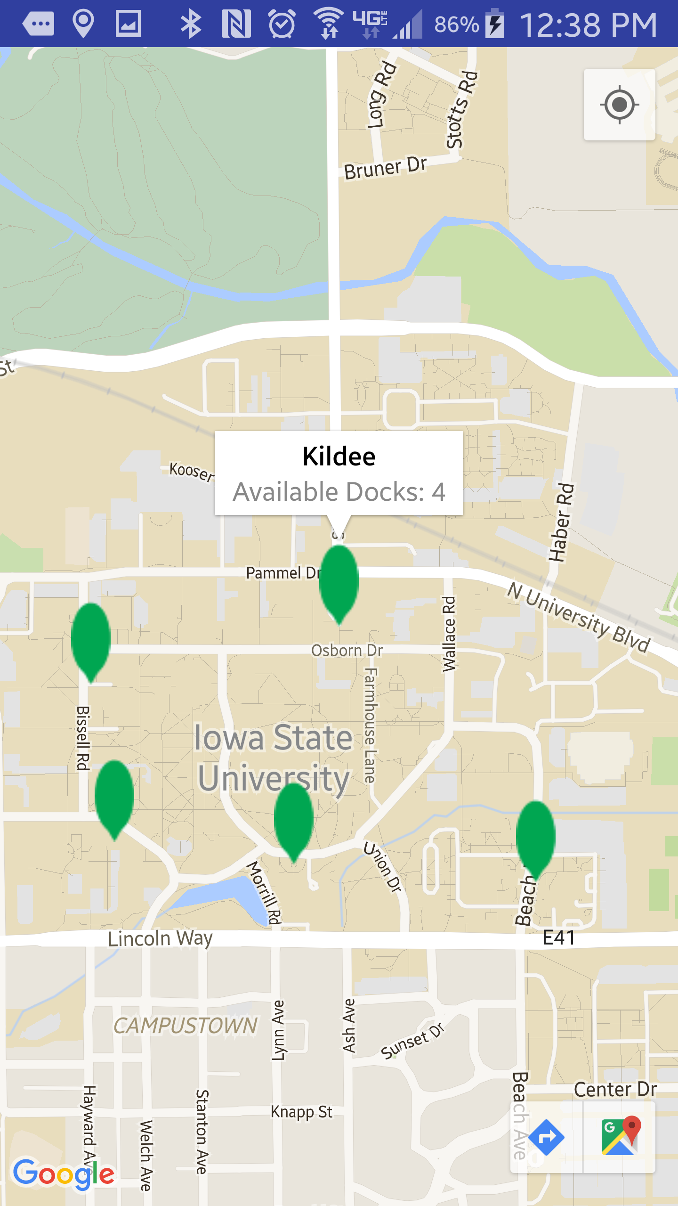
Status of Android Application
Android application GUI
Google Map integration into prototype Android application
Custom Markers based on Docks Available
Forms connected with Database
All Docks Available
3/4 Docks Available
Half Docks Available
1/4 Docks Available
No Docks Available

Slide 16
Status of Hardware
Circuit design
All of the hardware necessary for the new docking station has been received
The hardware is mostly connected and integrated with the docking station
In troubleshooting phase

Slide 17
Hardware Design

Slide 18
Hardware: Before and After
Before
After

Slide 20
Resource Estimate
Resource | Estimated Cost
Raspberry Pi | $40
Memory Card | $15
Relay | $10
Card Reader | $115
Power Supply | $30
LED Strip | $70
Display | $40
Solenoid | $30
Total | $350

Slide 21
Test Plan
Heating and Cooling tests have already been done with the hardware to ensure it will work in Iowa weather
Django unit testing to validate requirements
Android unit testing

Slide 22
Plan for Next Semester
Implement quick “plug-and-play” connections for docking hardware
Implement plan for mass production of software on Raspberry Pi’s
Communications from docking station to server
Finish Admin and Web Applications
Finish Android Application
Complete and execute our testing plan

Slide 23
Questions?

